Slide 1


Soundprism
An Online System for Score-informed Source Separation of Music Audio
Zhiyao Duan and Bryan Pardo
EECS Dept., Northwestern Univ.
Interactive Audio Lab, http://music.cs.northwestern.edu
For presentation in MMIRG2011, Evanston, IL
Based on a paper accepted by IEEE Journal of Selected Topics on Signal Processing

Slide 2
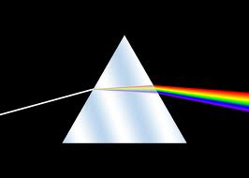

From Prism to Soundprism

Slide 3
Potential Applications
Personalize one’s favorite mix in live concerts or broadcasts
Music-Minus-One then Music-Plus-One
Music editing

Slide 4
Related Work
Assume audio and score are well-aligned
  [Raphael, 2008]
  [Hennequin, David & Badeau, 2011]
Use Dynamic Time Warping (DTW), offline
  [Woodruff, Pardo & Dannenberg, 2006]
  [Ganseman, Mysore, Scheunders & Abel, 2010]
To our knowledge, no existing work addresses online score-informed source separation

Slide 5
System Overview

Slide 6
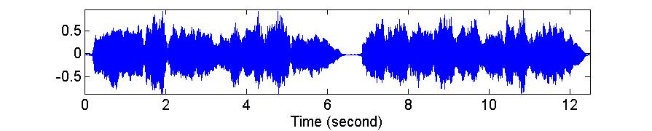
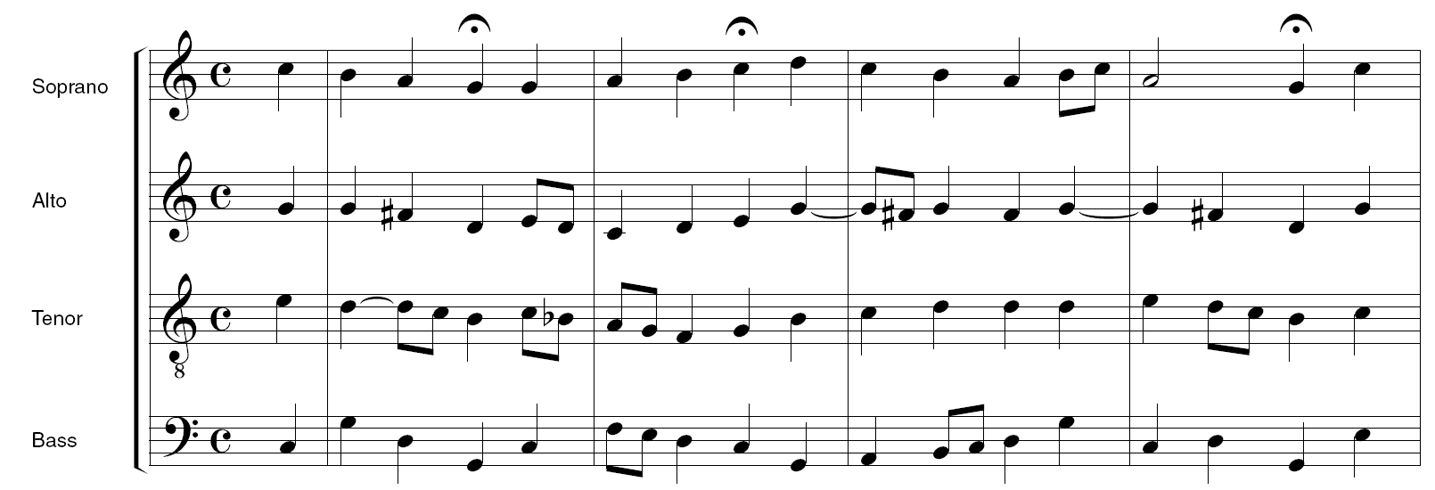
Score Following
Given a score, there is a 2-d performance space
View an performance as a path in the space
Task: estimate the path of the audio performance
Tempo
(BPM)
Score position (beats)

Slide 7


Design the Model
Decompose audio into frames (46ms long) as observations
Create a state variable (to be estimated later ) for each frame
Define a state process model (Markovian)
Define an observation model
Observs
Audio frame
…
Tempo
…
States
Score position
?
Hidden Markov Process

Slide 8
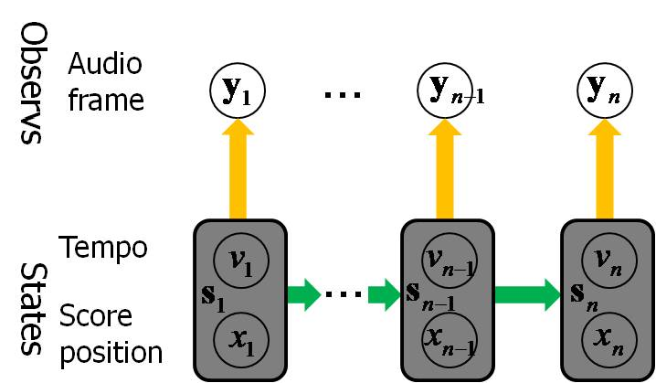



Process Model
Transition prob. between previous and current states
Dynamical system
  Position:
  Tempo:
  where
tempo noise
If the previous position just passed a score onset
otherwise

Slide 9



Observation Model
Generation prob. from current state to observation
was trained on thousands of isolated musical chords as in [1]
Define
deterministic
probabilistic
[1] Z. Duan, B. Pardo and C. Zhang, “Multiple fundamental frequency estimation by modeling spectral peaks and non-peak regions,” IEEE Trans. Audio Speech Language Process. Vol. 18, no. 8, pp. 2121-2133, 2010.

Slide 10


Inference
Given models
Infer the hidden state from previous observations
i.e. Estimate , then decide
By particle filtering

Slide 11
System Overview

Slide 12


Source Separation
1. Accurately estimate performed pitches
  Around score pitches

Slide 13
Reconstruct Source Signals
2. Allocate mixture’s spectral energy
  Non-harmonic bins
    To all sources, evenly
  Non-overlapping harmonic bins
    To the active source, solely
  Overlapping harmonic bins
    To active sources, in inverse proportion to the square of harmonic numbers
3. Inverse Fourier transform with mixture’s phase
Amplitude
Frequency bins
Harmonic positions for Source 1
0 | 1 | 0 | 1 | 0 | 1 | 0 | 1 | 0 | 1
0 | 0 | 1 | 0 | 0 | 1 | 0 | 0 | 1 | 0
Harmonic positions for Source 2

Slide 14
Experiments on Real Performances
Data source
  Score: 10 pieces of J.S. Bach 4-part chorales
  Audio: played by a quartet (violin, clarinet, saxophone, bassoon). Each part was individually recorded while the performer was listening to others
  Score: constant tempo; audio: tempo varies, fermata
Data set
  All 15 combinations of 4 parts of each piece
  150 pieces = 40 solo pieces + 60 duets + 40 trios + 10 quartets
Ground-truth alignment
  Manually annotated

Slide 15
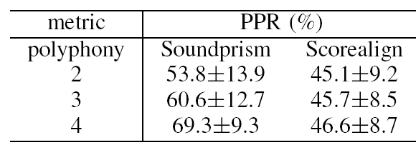
Score Following Results
Align Rate (AR): percentage of correctly aligned notes in the score (unit: %)
  where is the onset of the note
Scorealign: an offline DTW-based algorithm [2]
[2] N. Hu, R.B. Dannenberg and G. Tzanetakis, “Polyphonic audio matching and alignment for music retrieval,” in Proc. WASPAA, New Paltz, New York, USA, 2003, pp. 185-188.

Slide 16
Source Separation Results
1. Soundprism
2. Ideally-aligned
  Ground-truth alignment + separation
3. Ganseman10
  Offline algorithm
  DTW alignment
  Train source model from MIDI synthesized audio
4. MPET (score not used)
  Multi-pitch tracking + separation
5. Oracle (theoretical upper bound)
Results on 110 pieces

Slide 17
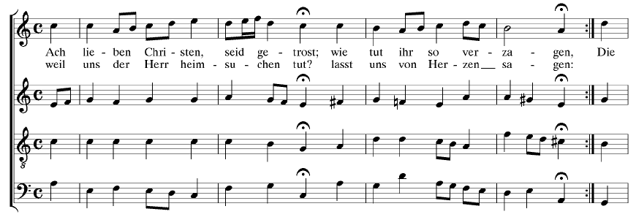
Examples
“Ach lieben Christen, seid getrost”, by J.S. Bach
  MIDI Audio Aligned audio with MIDI
  Separated sources

Slide 18
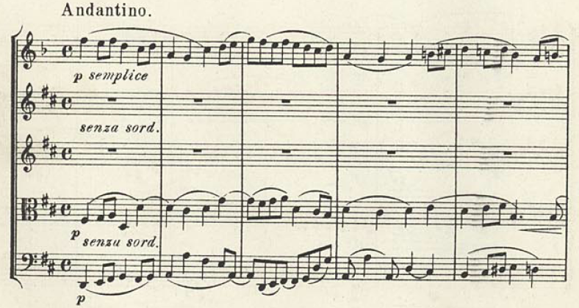
Examples cont.
Clarinet Quintet in B minor, op.115. 3rd movement, by J. Brahms, from RWC database
  MIDI Audio Aligned audio with MIDI
  Separated sources

Slide 19
Conclusions
Soundprism: an online score-informed source separation algorithm
A hidden Markov process model for score following
  View a performance as a path in the 2-d state space
  Use multi-pitch information in the observation model
A simple algorithm for source separation
Experiments on a real music dataset
  Score following outperforms an offline algorithm
  Source separation outperforms an offline score-informed source separation algorithm
  Opens interesting potential applications

Slide 20

Thank you!

Slide 21
Source Separation Results
Soundprism
Ideally-aligned
  Ground-truth alignment + separation
Ganseman10
  Offline algorithm
  DTW alignment
  Train source model from MIDI synthesized audio
MPET (score not used)
  Multi-pitch tracking + separation
Oracle (theoretical upper bound)
Results on 60 duets

Slide 22
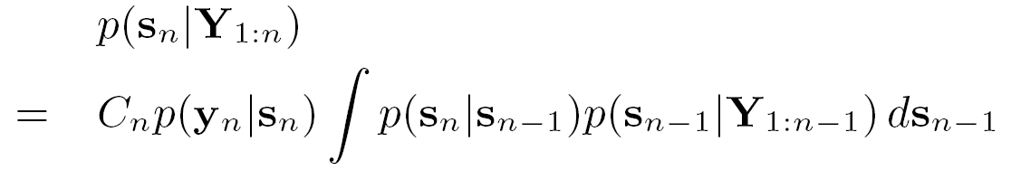

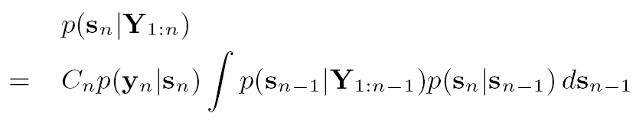

Inference by Particle Filtering
Represent and update the distribution by a fixed number of particles
  Randomize 1000 particles at the 1st frame: ,
  For the n^{th} frame
    Update particles using the process model
    Calculate weights using the observation model
    Sample particles according to their weights
    Output mean of the particles as the estimate of the current state
Particles represent

